Slide 1
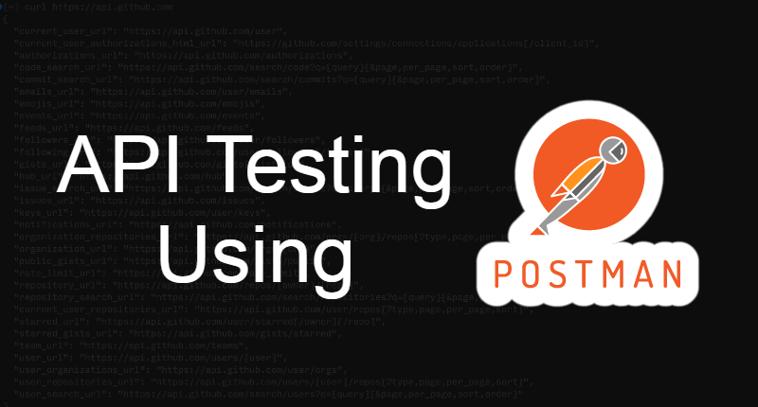
By - Manas Tuwani

Slide 2
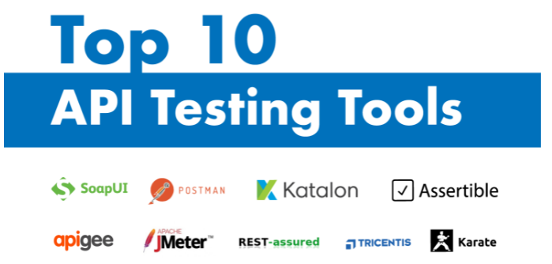
API Testing Tool
Some of the tools used for API Testing are as follows:
Postman
Swagger
Katalon Studio
SoapUI
Assertible
Tricentis Tosca
Apigee
JMeter
Rest-Assured
Karate DSL
API Fortress
HP QTP(UFT)

Slide 3
What is Postman
Postman is a collaboration platform for API development. It is a popular API client and it enables you to design, build, share, test, and document APIs.
Using the Postman tool, we can send HTTP/s requests to a service, as well as get their responses. By doing this we can make sure that the service is up and running.
Being originally a Chrome browser plugin, Postman now extends its solution with the native version for both Mac and Windows.

Slide 4
Why Postman ?
Postman has become a tool of choice for over 50 million users.
Free: It is free to download and use for teams of any size.
Easy: Just download it and send your first request in minutes.
APIs Support: You can make any kind of API call (REST, SOAP, or plain HTTP) and easily inspect even the largest responses.
Extensible: You can customize it for your needs with the Postman API.
Integration: You can easily integrate test suites into your preferred CI/CD service with Newman (command line collection runner)
Community & Support: It has a huge community forum

Slide 5
Postman Collection
The collection is a combination of multiple API requests
A Postman Collection lets us group individual requests together. Simply it allows us to organize the requests into folders.

Slide 6
End point: Address where API is hosted on the Server./Base URL
Structure of URL:
End Point Request URL can be constructed as below
Base URL/resource/(Query/Path)Parameters
https://www.google.com/search?q=google
Note: Sometime query parameter will be there and sometime not

Slide 7
Resources
Resources represent API/Collection which can be accessed from the Server
google.com/maps google.com/search google.com/images

Slide 8
Query Parameters
Query Parameter is used to search/sort/filter the resources.
Query Parameters are identified with “?”
https://amazon.com/orders?sort_by=2/20/2024

Slide 9
Path Parameters
Path parameters are variable parts of a URL path. They are typically used to point to a specific resource within a collection, such as a user identified by ID
https://www.google.com/Images/1123343 https://www.google.com/docs/1123343 https://amazon.com/orders/112
https://www.google.com/search?q=newyork&oq=newyork&aqs=chrome..69i57j0l7.2501j0j7&sourceid=chrome&ie=UTF-8

Slide 10
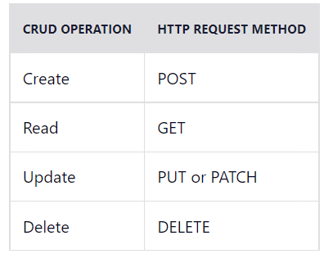
What is CRUD ?
CRUD refers to the four basic operations a software application should be able to perform – Create, Read, Update, and Delete.
In such apps, users must be able to create data, have access to the data in the UI by reading the data, update or edit the data, and delete the data.

Slide 11
GET API
The GET method is used to extract information from the given server using a given URL. While using GET request, it should only extract data and should have no other effect on the data. No Payload/Body required
It enables you to retrieve/read data from a server

Slide 12
POST API
A POST request is used to send data to the server, for example, customer information, file upload, etc. using HTML forms.
It enables you to add data to an existing file or resource in a server
How to send input data in POST? Ans: Using Body/ Payload

Slide 13
PUT API
Replaces/Modify all the existing resources which are already present in server.
It lets you replace/modify an existing file or resource in a server

Slide 14
DELETE API
Delete all the existing resources which are already present in server.
Delete API lets you to delete an existing file/record in a server

Slide 15
Headers/Cookies
Headers represent the meta-data associated with the API request and response. In layman terms, we were sending Additional details to API to process our request.
Example : Authorization details

Slide 16
Name some most commonly used HTTP methods?
Some of the HTTP methods are:
GET: It enables you to retrieve data from a server POST: It enables you to add data to an existing file or resource in a server PUT: It lets you replace an existing file or resource in a server DELETE: It lets you delete data from a server PATCH: It is used to apply partial modifications to a resource OPTIONS: It is used to describe the communication options for the target resource

Slide 17
HTTP STATUS CODE
1xx : Informational Message
2xx: Successful
4xx: Client Error
5xx: Server Error

Slide 18
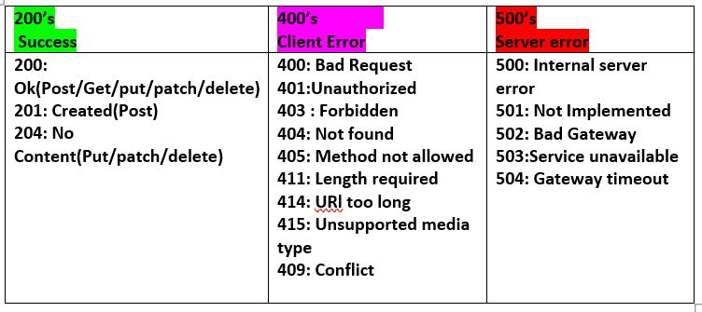
HTTP STATUS CODE

Slide 19
Success Code
201/200/204 : When data is successfully created/Updated/deleted/fetched (Via either POST,PUT,PATCH,GET,DELETE)in your data base
Client Error
400 Bad Request: The request could not be understood by the server due to Bad syntax.
401 Unauthorized : If invalid authentication token is used.
404 Not found: If any properties/Object/Recourse not found in the data base.
403 Forbidden : Error code for user not authorized to perform the operation or the resource is unavailable for some reason (e.g.User trying to access other data, time constraints, etc.).

Slide 20
Server Error
500: Internal server error : The server encountered an unexpected condition which prevented it from fulfilling the request. The general catch-all error when the server-side throws an exception.
502: Bad Gateway: The server, while acting as a gateway or proxy, received an invalid response from the upstream server it accessed in attempting to fulfill the request.
504: Gateway timeout :The server was acting as a gateway or proxy and did not receive a timely response from the upstream server.
503:Service unavailable: The server is currently unavailable (because it is overloaded or down for maintenance). Generally, this is a temporary state.

Slide 21
What exactly needs to be verified in API Testing
1. API Response 2. Data accuracy 3. HTTP status codes 4. Response time 5. Error codes in case API return any errors 6. Authorization checks 7. Non-functional testing such as performance testing, security testing

Slide 22
What are the core components of an HTTP request?
Basically, on API Testing, we send a request to the API with the known data and we analyze the response.
1. HTTP Request method like PUT, POST. 2. API End point URL 3. Resources and Parameters 4. Request Headers If Required 5. Response body/Payload

Slide 23
What do you understand by payload in Restful Web service?
Payload/Body is the secured input data which is sent to API to process the request.
In REST API, a payload refers to the data or information sent by the client in a request to the server.
Payload is generally represented in JSON format in Rest API.
Payload is used only in methods that support a body, such as POST, DELETE, PUT, and PATCH

Slide 24
What is the difference between PUT and POST methods
PUT and POST methods are sometimes confused in regards to when each should be used. Using POST request, our intent is to create a new object on the server whereas with PUT request, our intent is to replace an object by another object.
POST should be used when the client sends the page to the server and then the server lets the client know where it put it. PUT should be used when the client specifies the location of the page

